Slide 1

Camera Surveillance System
Keeping an eye on things.

Slide 2
Project Idea
Simple Home Surveillance System
Affordable (uses whatever camera you have available)
Stores data on device only (configurable)
Intuitive (easy setup and simple UX as far as possible)
AI - Learn who has access to zone being watched, identify potential intruders
Whitelist (friends, family, pets etc)
Set “lockdown” time blocks
Configure communication channel for notifications (Telegram, email, SMS)
Involves integration 3’rd party services for comms

Slide 3
Motivation
Privacy and Security: Existing camera surveillance systems often rely on cloud storage, which raises concerns about data privacy and security breaches.^{1, 2}
Cost-Effectiveness: Professional camera kits, although becoming more affordable, can still be expensive making them less accessible to individuals on a limited budget.
User-Friendly Interface: Many existing surveillance systems have complex setups and un-intuitive user interfaces, making them difficult to configure and operate.
Customizability: Every home has unique surveillance requirements.
Eufy cameras send data to cloud without consent: https://www.zdnet.com/article/eufys-security-cameras-send-data-to-the-cloud-without-consent-and-thats-not-the-worst-part/
Xiaomi WiFi cameras unauthorized access: https://www.thequint.com/tech-and-auto/tech-news/xiaomi-mi-hope-app-disabled-security-camera-shows-stranger-photos

Slide 4
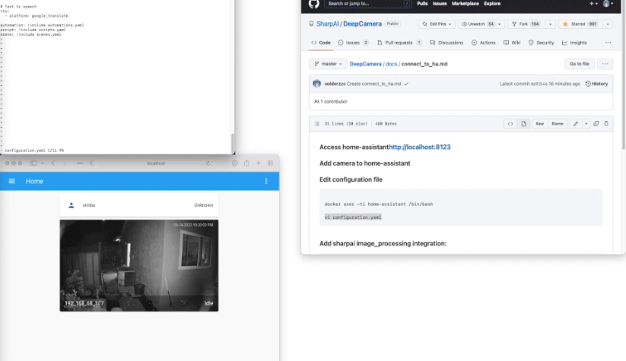
Related Project #1: SharpAI Deep Camera
The DeepCamera project is an open-source AI camera that can be used to empower any camera/CCTV with state-of-the-art AI, including facial recognition, person recognition(RE-ID) car detection, fall detection and more.
Is still under development, which means that it may not be as stable or reliable.
Can be computationally expensive to run, may not be suitable for all devices.
Requires technical knowledge to use, may be a barrier for some users.

Slide 5
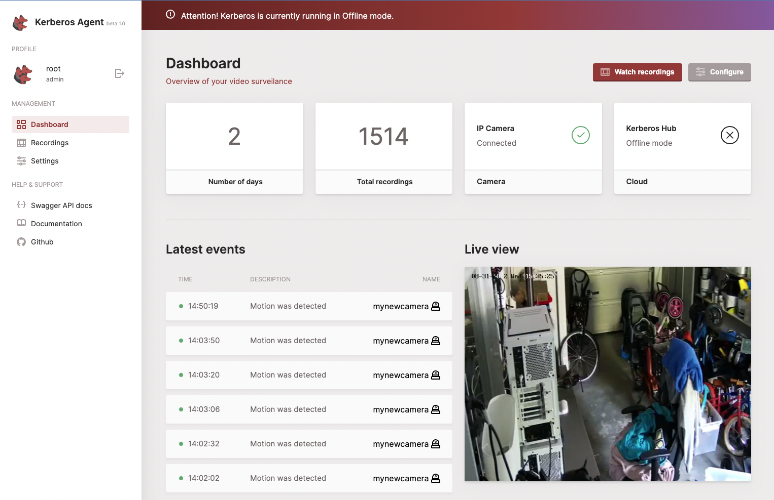
Related Project #2: Kerberos Agent
Kerberos Agent is a powerful tool that can be used to manage a large number of cameras and is especially suited for business/corporate needs.
Can be complex to set up and manage, especially for large deployments.
Requires some technical knowledge to use, which may be a barrier for some users.
May not be suited for small scale usage.

Slide 6
What’s missing?
Although these solutions are great for larger setups, we’re aiming for:
Speed (fast onboarding, setup and responsive system)
Simplicity (in understanding how to use the system)
Furthermore, with data privacy being of a larger concern now more than ever, our goal is to ensure privacy is considered from the start. No data is sent to a central server and the user has full control over what is stored where.

Slide 7
Research
A Survey of Deep Learning Methods for Object Detection in Video Surveillance by Y. Gong, L. Wang, and S. Yan (2019)
Discusses the use of 3 approaches, namely: R-CNN, YOLO, and SSD
YOLO (You Only Look Once) seems appropriate for our use case
Not the highest accuracy, but more efficient processing (keeping speed and affordability in mind)
Paper found here: https://arxiv.org/pdf/1907.09408.pdf

Slide 8
Research Cont.
Home Automation and Surveillance: A Review by K.S. Pachpor, Chandrashekhar Deshmukh, and Kapil Pachpor (April, 2019)
Reviews various papers on the the state of the art of home surveillance system, covering privacy and security issues as well as methods of mitigation, cost, efficiency etc.
Paper found here: https://www.researchgate.net/publication/332326081_Home_Automation_and_Surveillance_A_Review

